Slide 1
The use of mixture distributions in a Bayesian linear mixed effects model
Anirudh TOMER
Promoter: Professor Emmanuel LESAFFRE

Slide 2
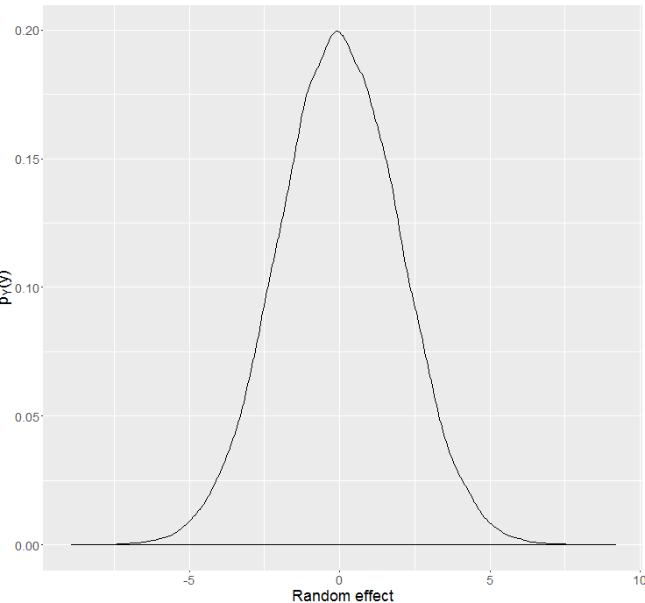
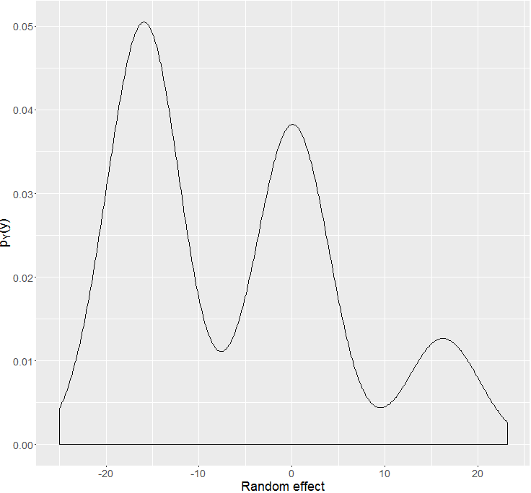
Bayesian heterogeneity model
Vs.

Slide 3
What is the problem we are facing?
Estimation of mixture component density parameters $θ_{G}$
Estimation of mixture component density parameters 𝜃_𝐺
Criteria for choice of number of components (DIC, Marginal likelihood, Predictive methods)
Classification of observations into groups

Slide 4
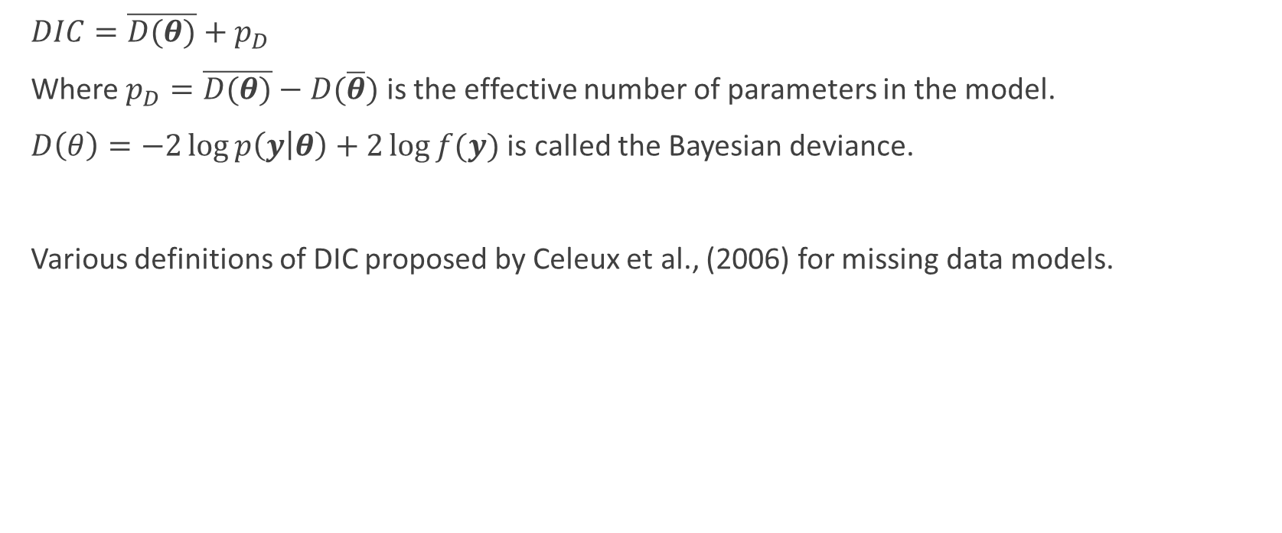
DIC (deviance information criteria)
$DIC=\overline{D(θ)}+p_{D}$
Where $p_{D}=\overline{D(θ)}−D(\overline{θ})$is the effective number of parameters in the model.
$D\left(θ\right)=−2\log{p\left(y | θ\right)}+2\log{f(y)}$ is called the Bayesian deviance.
Various definitions of DIC proposed by Celeux et al., (2006) for missing data models.

Slide 5

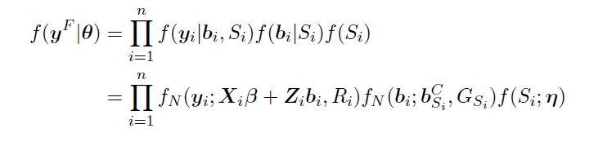



Marginal/Complete/Conditional likelihood
$$X_{i}, Z_{i}$$
$$β, b_{k}^{C}$$
$$G_{k}, R_{i}$$
$$η_{k}, S_{i}, b_{i}$$
$$?$$

Slide 6





Marginal DIC definitions

Slide 7
Complete and conditional DIC definitions

Slide 8


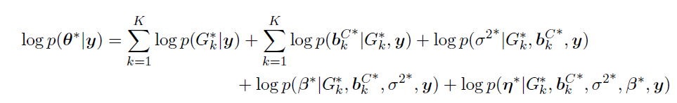
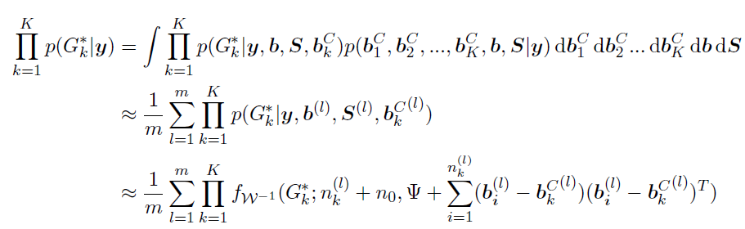
Marginal likelihood using Chib’s approximation

Slide 9



Posterior predictive checks
Motivation: Testing for overfitting. Idea: Sample big values from empty components to obtain inflated test statistic.

Slide 10
Data sets
Zebu cow weights
Predictors were gender, birth year, age, time of measurement.
Various versions of the dataset which differed in number of mixture components for random effects, number of subjects, separation of mixture components and number of subjects per component.

Slide 11
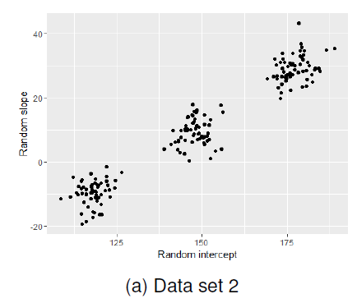
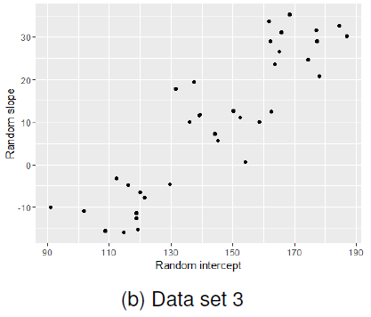


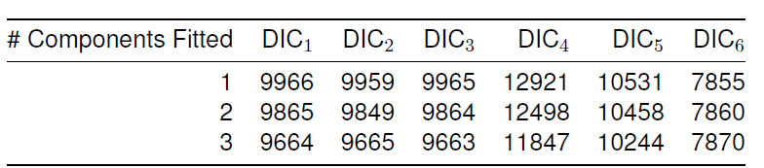
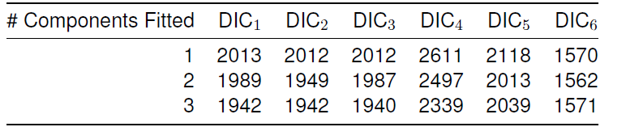
DIC results
DIC4 is most discerning.

Slide 12
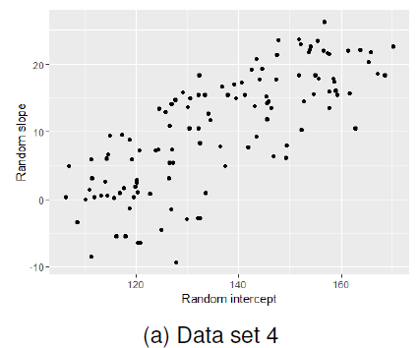
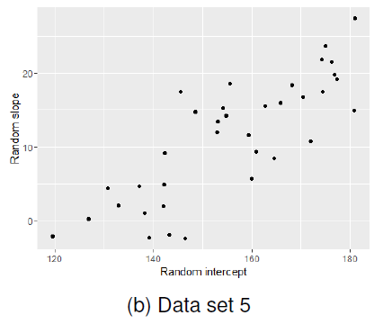
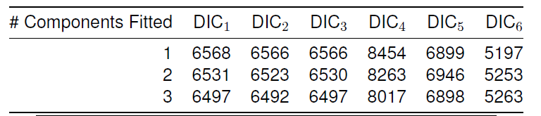
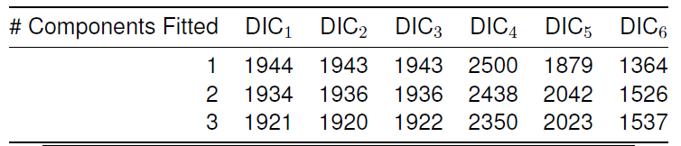
DIC results
Less sample size, fused components→ DIC is not much discerning for anything other than DIC4

Slide 13
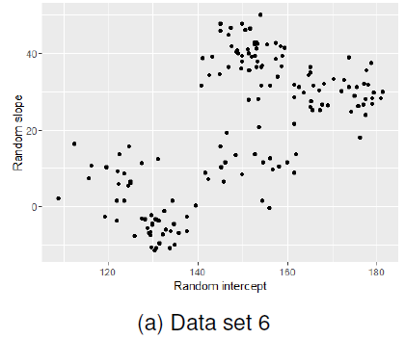
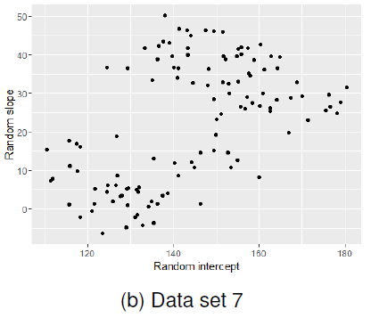

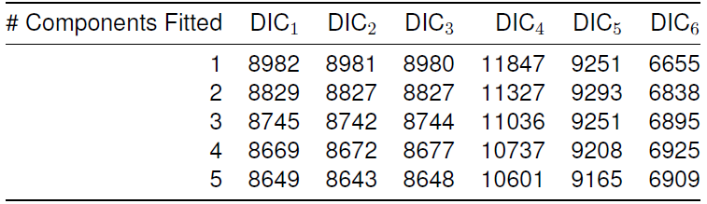
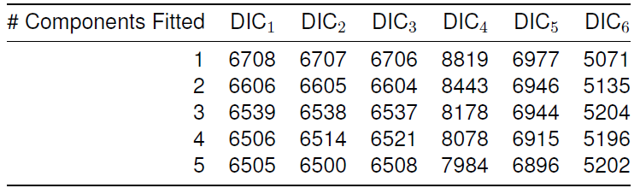
DIC results

Slide 14
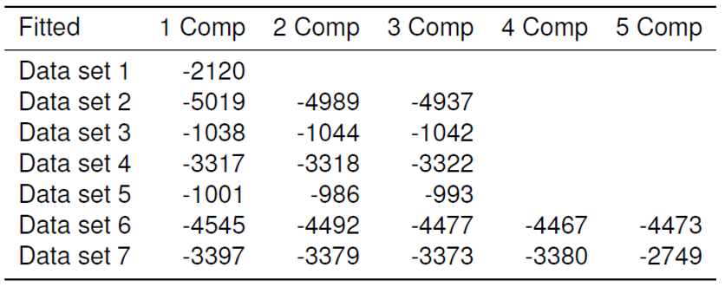

Marginal likelihood results $(\log{\hat{m}\left(y\right)})$

Slide 15
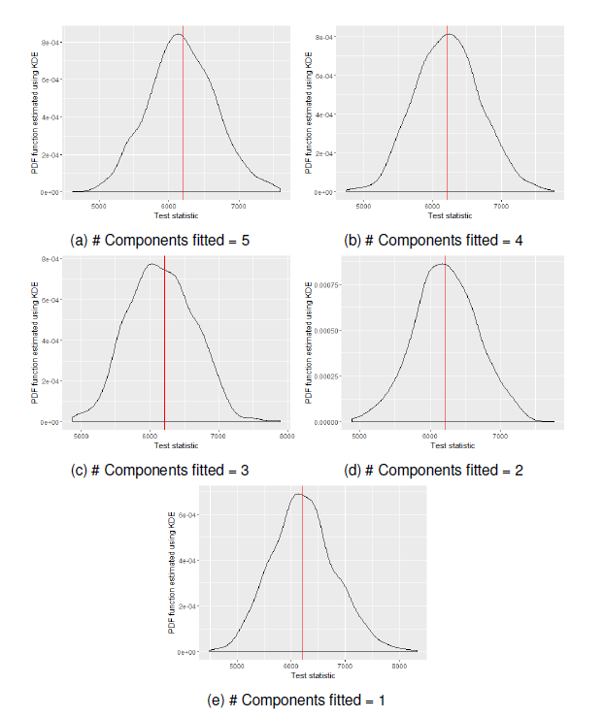
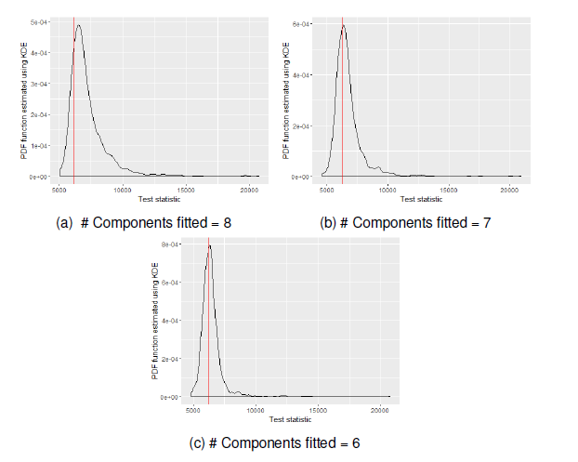
PPC results (data set 6) Using Wishart prior for covariance matrix

Slide 16
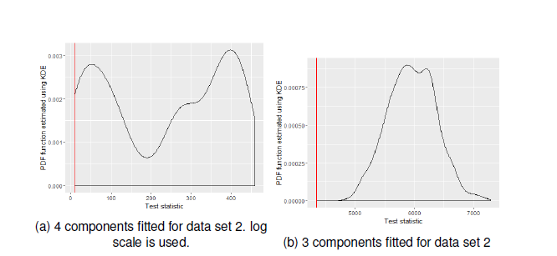
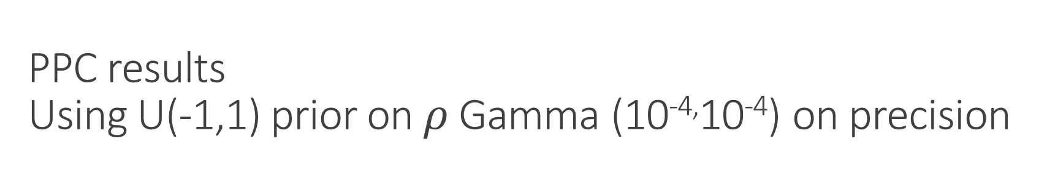
PPC results Using U(-1,1) prior on $ρ$ Gamma (10^{-4,}10⁻⁴) on precision
a) Overfitting has a big penalty
b) posterior variances of random effects were underestimating the sample data’s variance covariance of the random effects. Bad model fit is detected with the test statistic

Slide 17

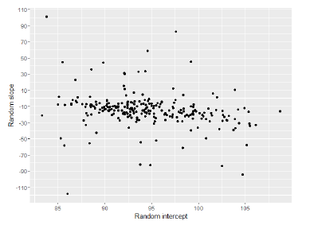
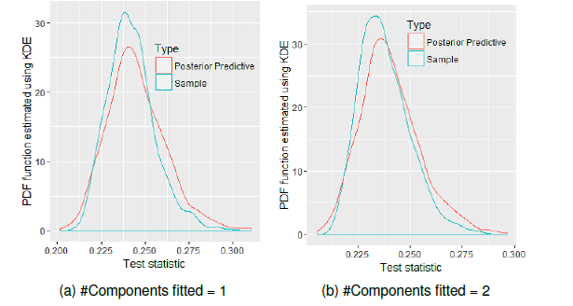
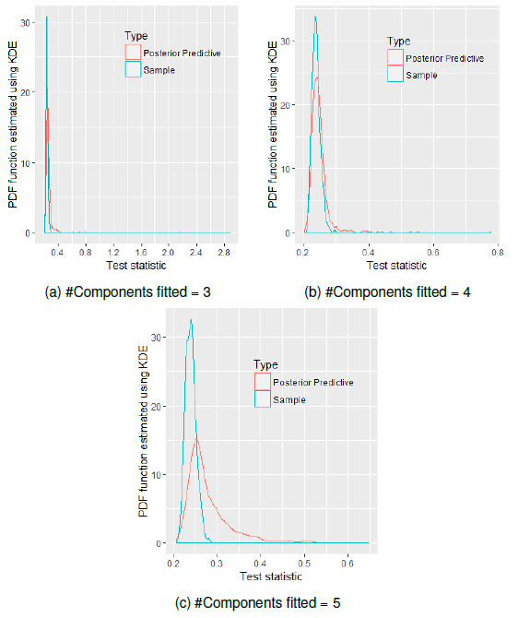
Blood donor data set analysis

Slide 18
Blood donor data set analysis
Component 1
Baseline random component of Hb level is low
Random slope is less negative relative to group 2.
Component 2
Baseline random component of Hb level is higher.
Average subject from group 2 has a more rapid decrease in Hb level levels with frequent donations.
Higher the baseline Hb level level, more likely to have a rapid decrease in Hb level levels with donations
Correlation between random slope and random intercept is most likely 0.

Slide 19
Other interesting results
Dirichlet prior with large parameter values. Incrementally increasing hyperparameter?
Chib’s approximation and chain length. Chib’s approximation when posterior’s do not belong to well known parametric families.
Wishart prior: underestimated posterior component variances if actual within subject variability > between subject variability.

